Slide 1
RRT* Implementation
Autonomous Robotics
WAI NWE TUN

Slide 2
Contents
RRT*
Implementation
Results
Limitations
References

Slide 3
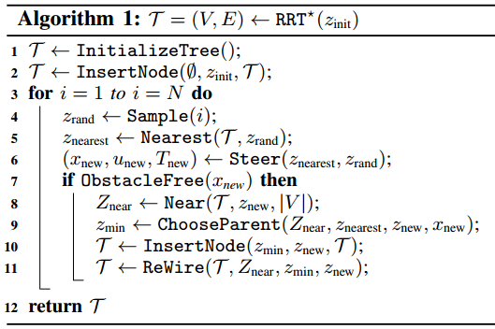
RRT*
RRT* starts with an empty tree and adds a single node corresponding to the initial state.
It finds solution to motion planning problem.

Slide 4
Implementation
It is assumed that there is no obstacles.
Cost is determined by Euclidean distance.
Six main functions are created:
getSample()
findNearest()
steering()
isObstacleFree()
getNeighbors()
chooseParent()
insertNode()
reWire()

Slide 5
Implementation
To run RRT*, eight inputs are necessary:
Starting point
Goal point
Obstacle points
Threshold value
Maximum number of nodes
Step size
Neighborhood size
Random generating seed
Output : total cost and time, locations of generated nodes

Slide 6
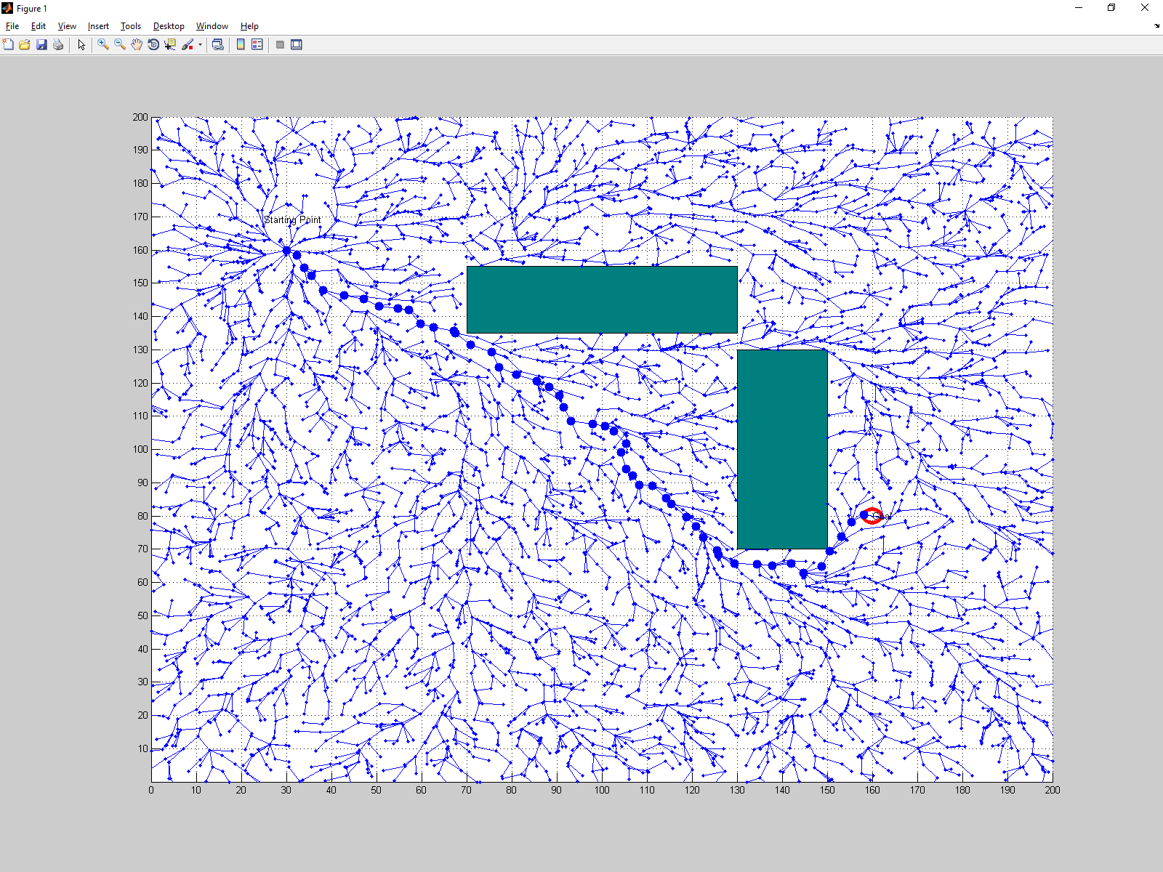
Result
Nodes: 5000 => Cost 208, Time: 104 sec

Slide 7
getSample()
This is to get a random node within ranges of x and y axis.
function node = getSample()
x = 0;
y = 0;
a = 0;
b = 200;
node = [x;y];
node(1) = (b-a) * rand(1) + a;
node(2) = (b-a) * rand(1) + a; end

Slide 8
findNearest()
This is to find the nearest node from the randomly generated new node (getSample()).
function indx = findNearest(rrt, n)
mindist = norm(rrt{1}.p - n);
indx = 1;
for i = 2:length(rrt)
dist = norm(rrt{i}.p - n);
if (dist<mindist)
mindist = dist;
indx = i;
end
end
end

Slide 9
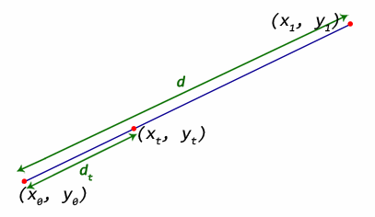
steering()
This is to find a new node which must be on the line of the random node and the nearest node, within the specified step size.
function new_node=steering(nearest_node, random_node)
dist = norm(random_node-nearest_node);
ratio_distance = param.step_size/dist;
x = (1-ratio_distance).* nearest_node(1)+ratio_distance
.* random_node(1);
y = (1-ratio_distance).* nearest_node(2) +ratio_distance
.* random_node(2);
new_node = [x;y];
end

Slide 10
isObstacleFree()
This is to check if an obstacle exists at the new steered point.
function free=isObstacleFree(node_free)
free = 1;
for i = 1: length(param.obstacles(:,1))
obstacle = param.obstacles(i,:);
op1 = [obstacle(1), obstacle(2)];
op2 = [op1(1)+obstacle(3), op1(2)];
op3 = [op2(1), op1(2) + obstacle(4)];
op4 = [op1(1), op3(2)];
nx = node_free(1);
ny = node_free(2);
if ((nx>=op1(1) && nx<=op2(1)) && (ny>=op1(2) && ny<=op4(2)))
free = 0;
end
end
end

Slide 11
getNeighbors()
This is to get a list of nodes within the specified neighborhood region.
function neighbors = getNeighbors(rrt, node)
neighbors = [];
for i = 1:length(rrt)
rrt{i}.p dist = norm(rrt{i}.p-node);
if (dist<=param.neighbourhood)
neighbors = [neighbors i];
end
end
end

Slide 12
chooseParent()
This is to choose the parent node for the new child node with the lowest cost from the root node.
function parent = chooseParent(rrt, neighbors, nearest, new_node)
min_cost = getCostFromRoot(rrt, nearest, new_node);
parent = nearest;
for i=1:length(neighbors)
cost = getCostFromRoot(rrt, neighbors(i), new_node);
if (cost<min_cost)
min_cost = cost;
parent = neighbors(i);
end
end
end

Slide 13
InsertNode()
This is to insert a node to the existing rrt tree.
function rrt = insertNode(rrt, parent, new_node)
node.p = new_node;
node.iPrev = parent;
node.cost = rrt{parent}.cost + norm(rrt{parent}.p-new_node);
rrt{end+1} = node;
end

Slide 14
reWire()
This is to reconsider to reconnect with the new node and its neighbor nodes if the cost is cheaper.
function rrt = reWire(rrt, neighbors, parent, new)
for i=1:length(neighbors)
cost = rrt{new}.cost + norm(rrt{neighbors(i)}.p - rrt{new}.p);
if (cost<rrt{neighbors(i)}.cost)
rrt{neighbors(i)}.iPrev = new;
end
end
end

Slide 15
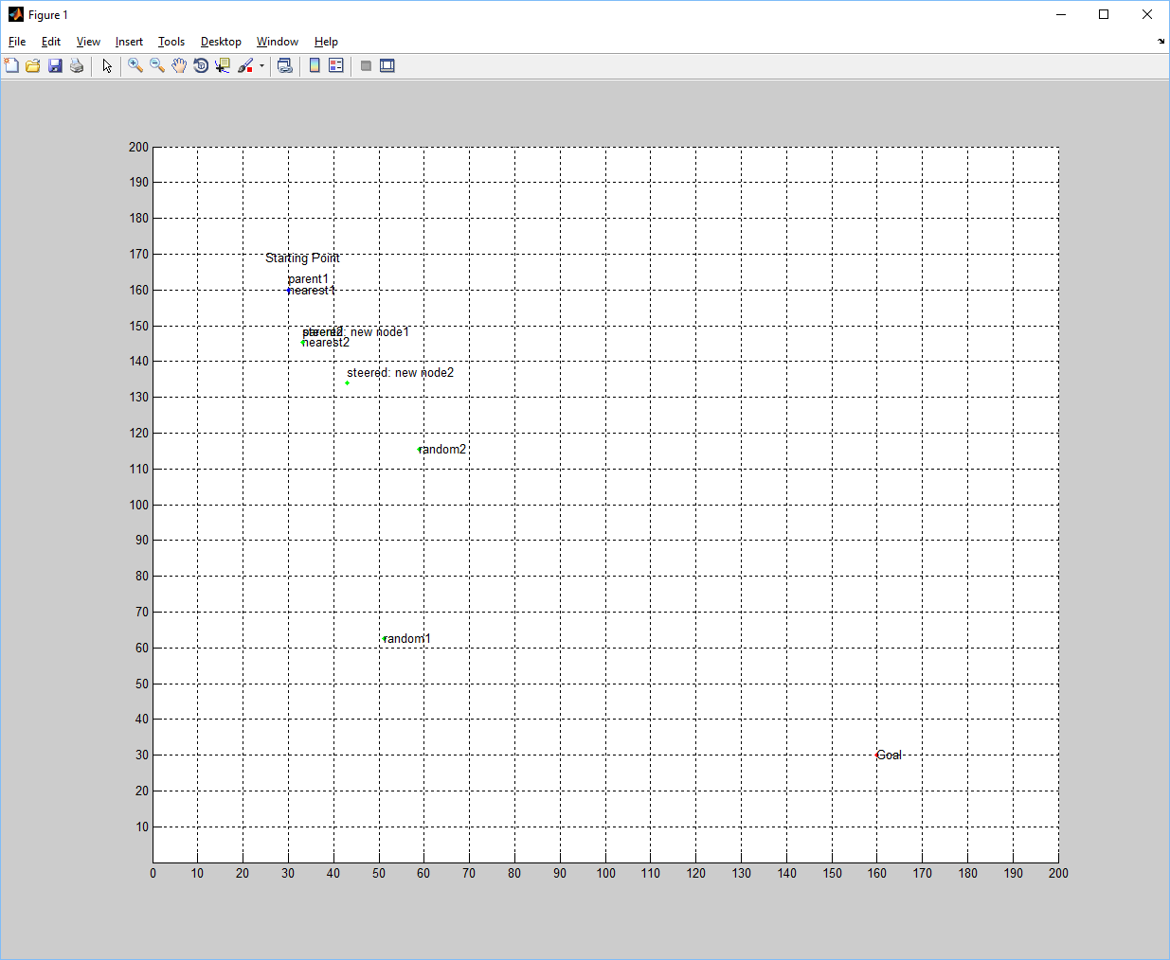
Result
Generating two new nodes

Slide 16
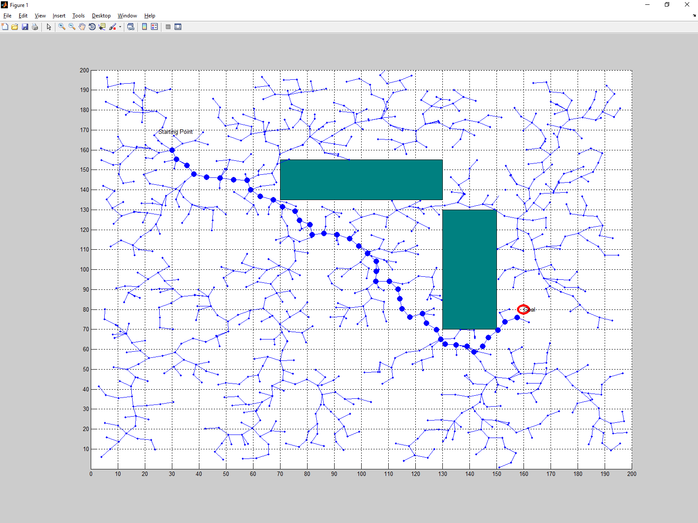
Result
Threshold = 3, Step size : 5, Nodes: 1000 => Cost: 205, Time: 6 sec

Slide 17
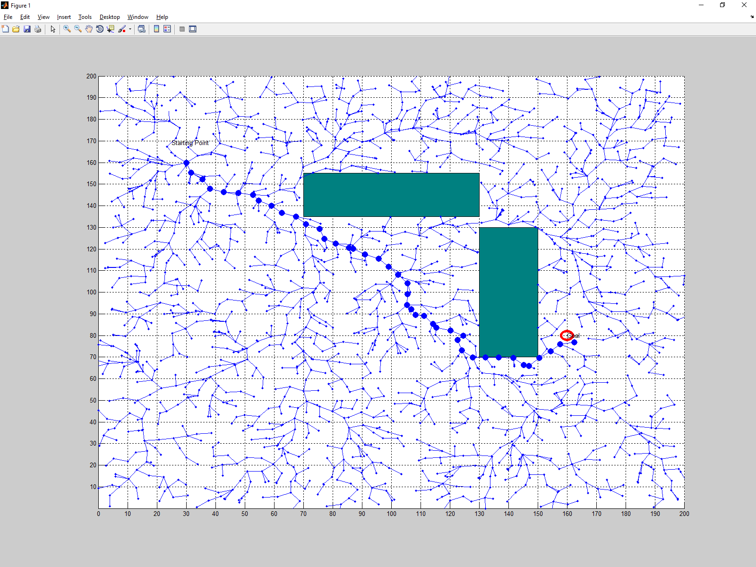
Result
Nodes: 2000 => Cost: 210, Time: 18 sec

Slide 18
Result
Nodes: 5000 => Cost 208, Time: 104 sec

Slide 19
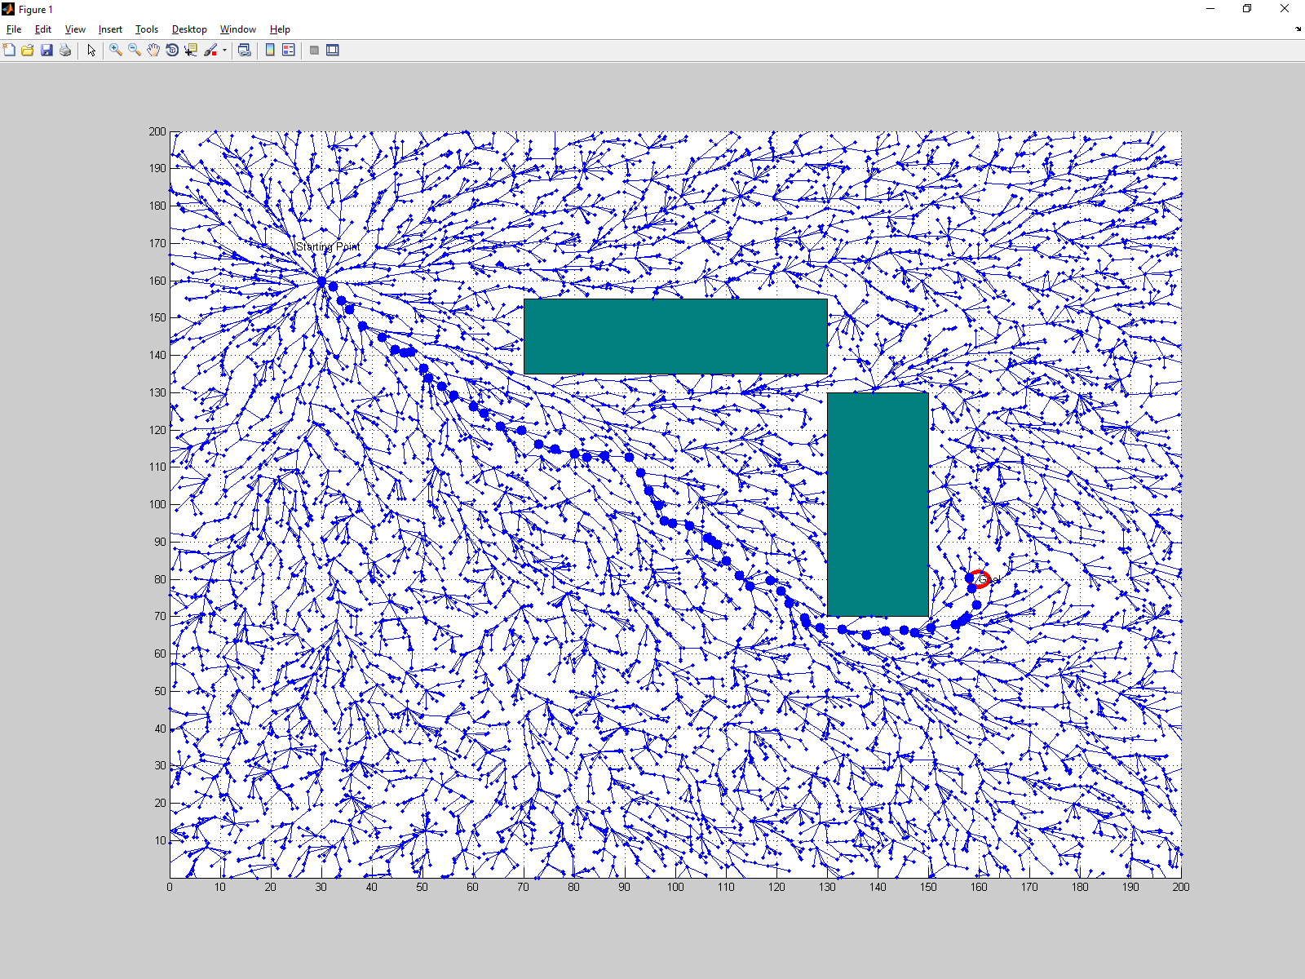
Result
Nodes: 8000 => Cost 206, Time: 256 sec

Slide 20
Limitations
Obstacle must be rectangle-shaped.
Obstacle can be detected only at the end points. Thus, if the end points is obstacle-free, it is considered as valid point even if line between the points passed through the obstacle.
Neighborhood size must be equal to step size.
No steering need not be performed in rewiring.
It is only available for 2D path planning problem.

Slide 21
References
S. Karaman, et. al., ‘Anytime Motion Planning using the RRT*,’ IEEE on Robotics and Automation, May 2011.
https://math.stackexchange.com/questions/175896/finding-a-point-along-a-line-a-certain-distance-away-from-another-point
https://github.com/vivekprayakarao
https://www.youtube.com/watch?v=JM7kmWE8Gtc&t=205s

